Slide 2
Unifying On-Premises and Cloud:
Practical Azure Arc Implementation
CLASS PREREQUSITES
Microsoft Authenticator
Access to Windows Remote Desktop
Matt Crumb
Solutions Architect | TD SYNNEX

Slide 3
Agenda
Azure Arc Overview
Arc-enabling On-premise Workloads
Arc-enabling AWS Workloads
Licensing Options
Other Azure Arc Features

Slide 4
What is Azure Arc?

Slide 5
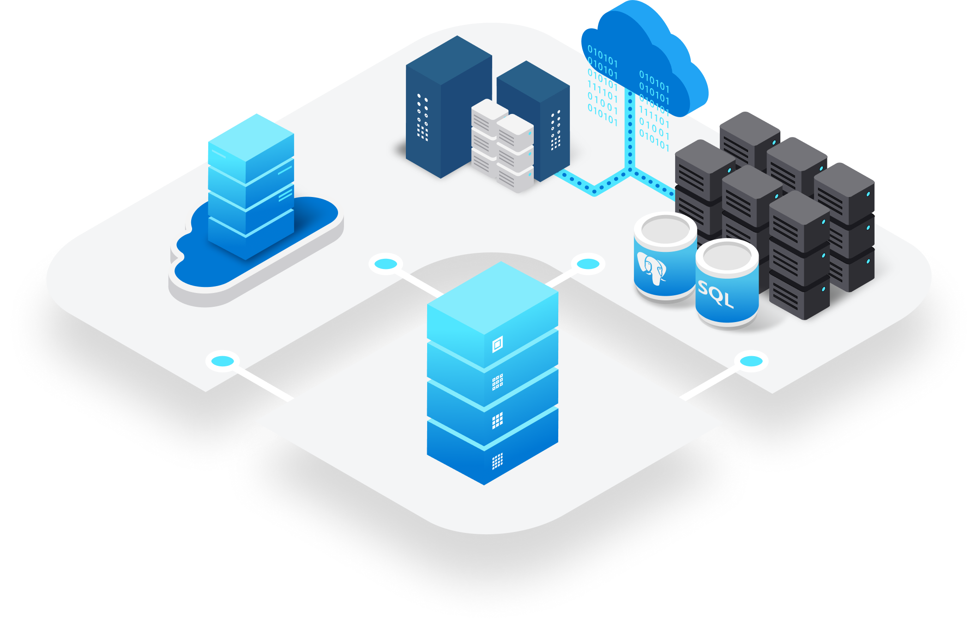
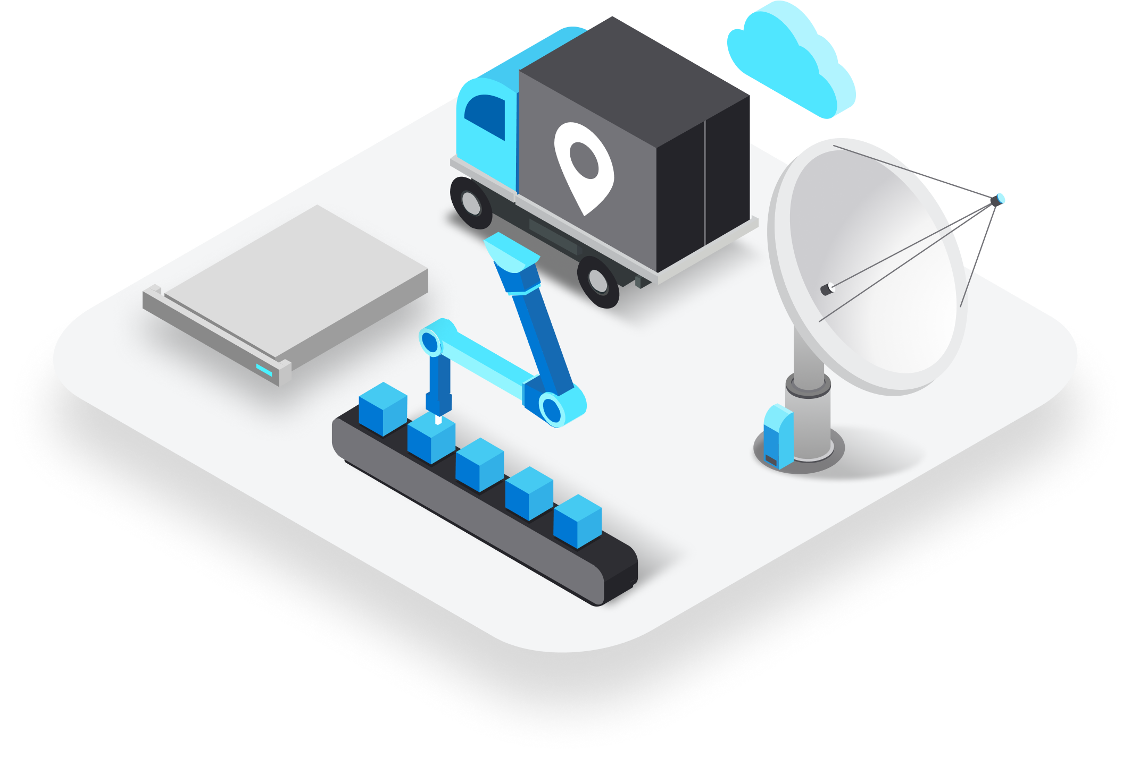
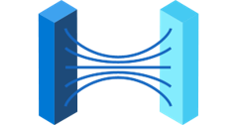


Azure Strategy Evolution
Datacenter
Edge
Migrate to the public cloud
Innovate anywhere across hybrid and on-prem
Azure 7+ years ago
Azure 4 years ago

Slide 6




Security, operations, and governance
Tools and experiences
Azure services
Azure Arc enabled services
Azure Arc
Cloud infrastructure
Azure Arc enabled infrastructure + devices
Innovate anywhere

Slide 7
Security, operations, and governance
Tools and experiences
Azure services
Azure Arc enabled services
Azure Arc
Cloud infrastructure
Azure Arc enabled infrastructure + devices
Innovate anywhere
Cloud regions
Regional edge
IT edge
IoT edge
50+ Azure regions
Multicloud
Operator DC
Co-Lo provider
Customer DC
Branch office
Factory floor
Retail store
Field production

Slide 8
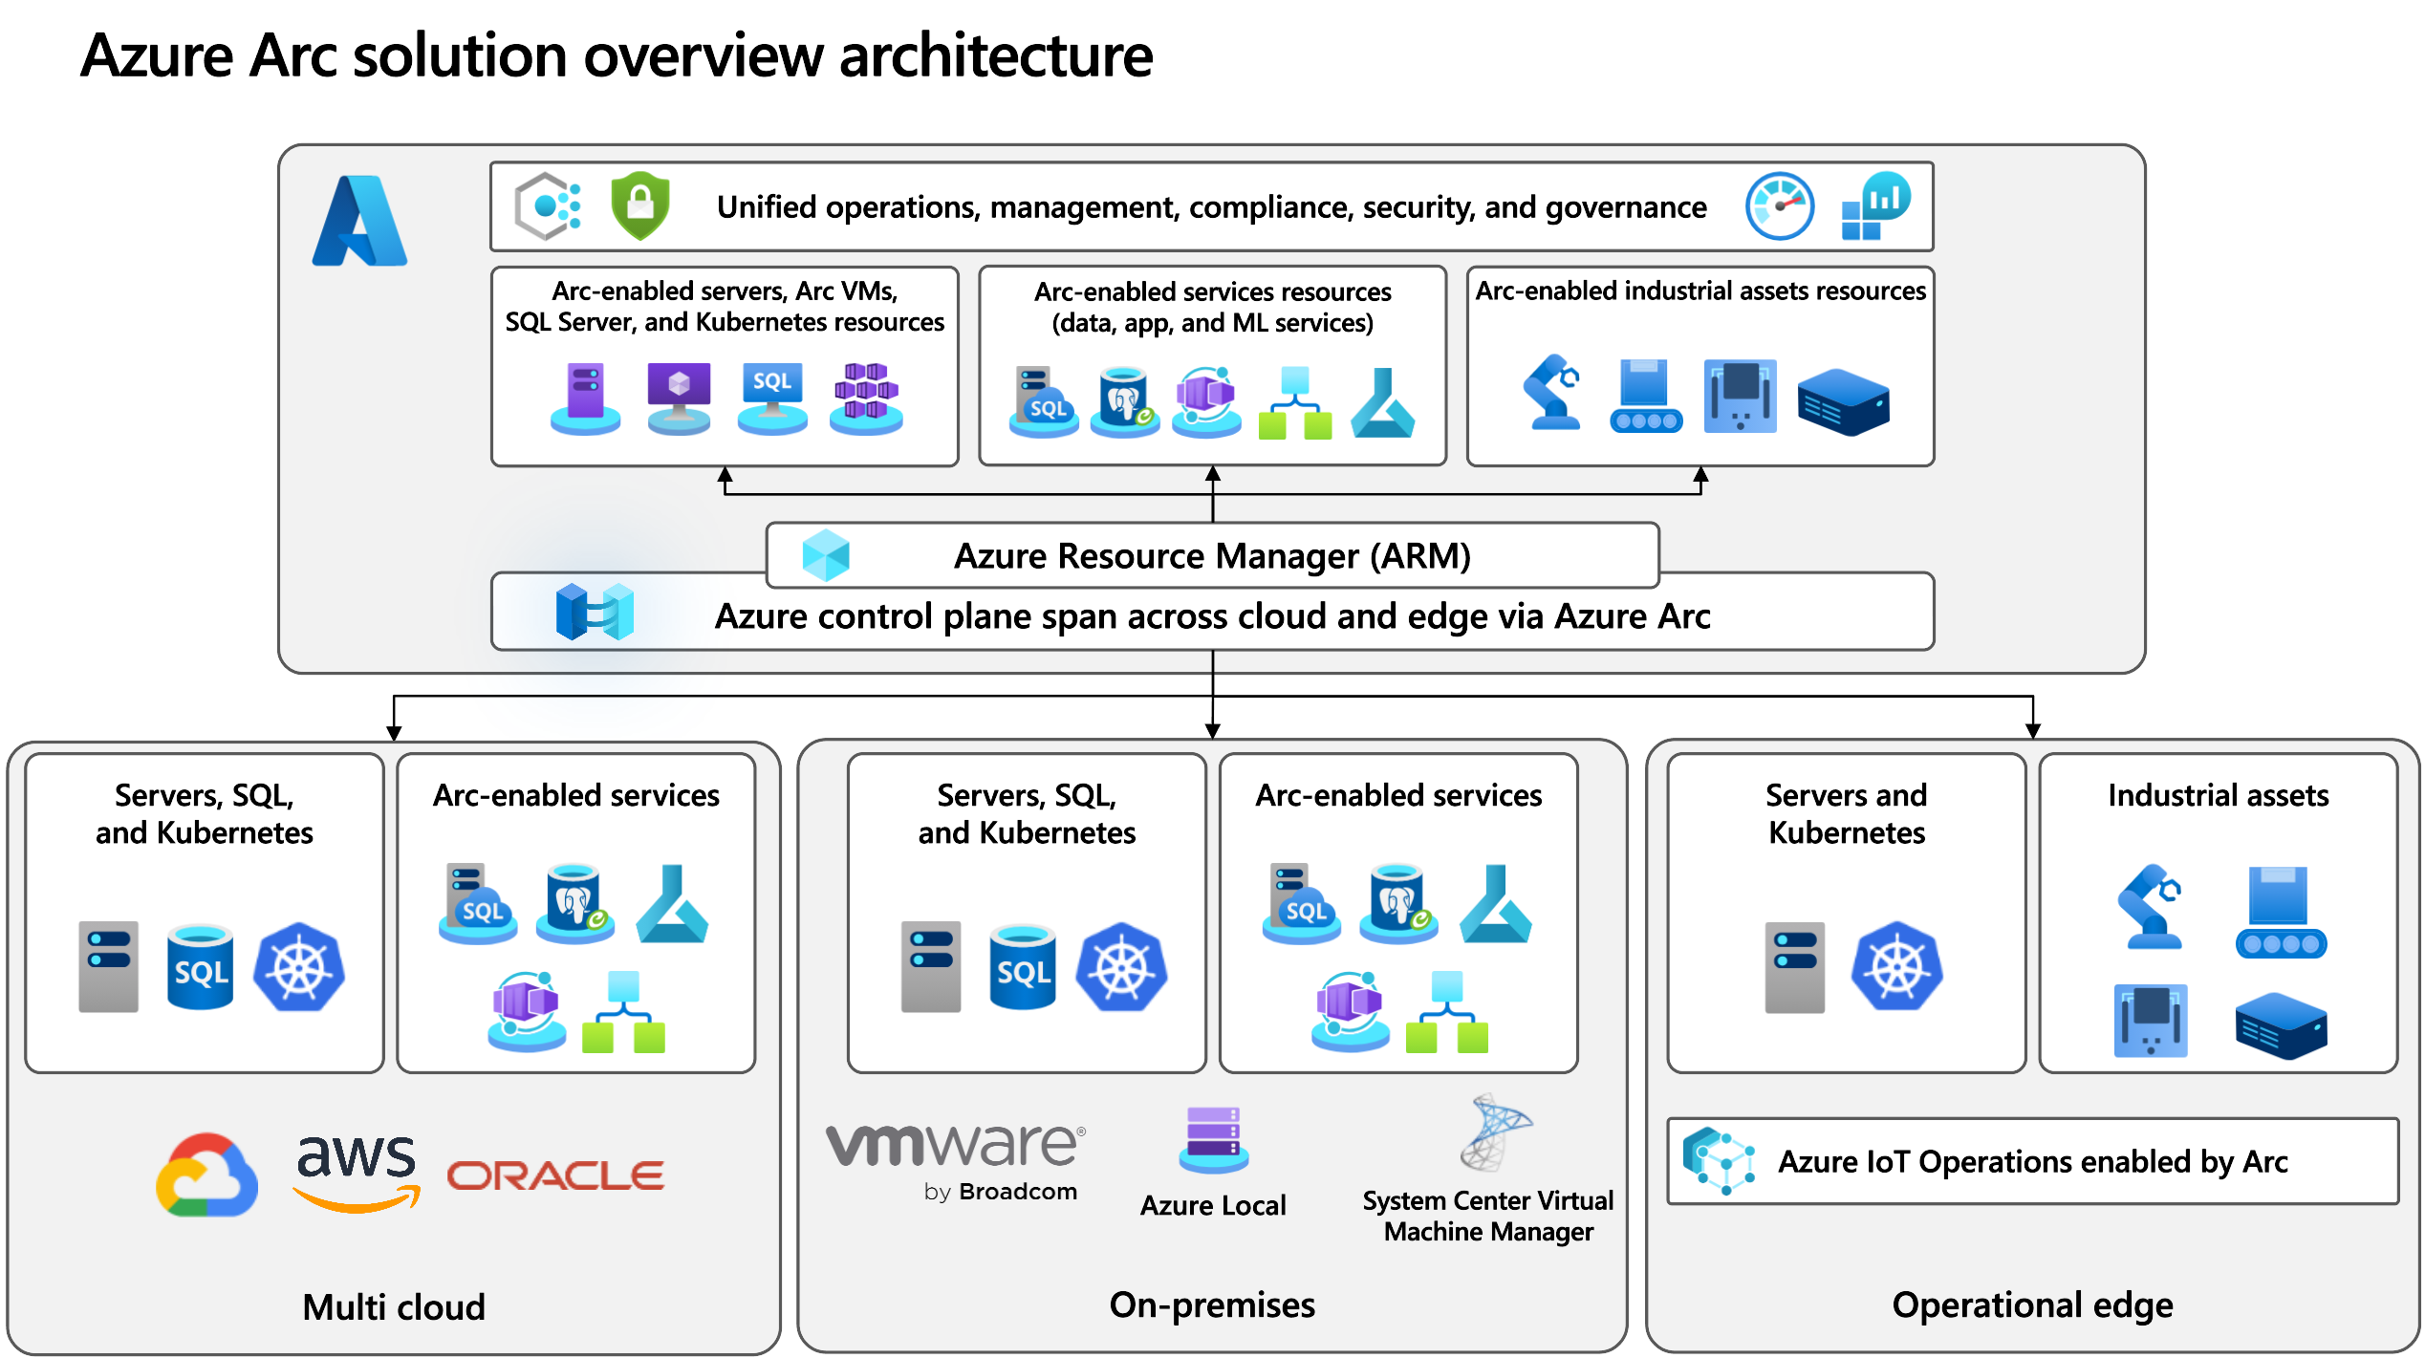

Slide 9
Hands-On Training

Slide 10
VM IP ADDRESSES
OnPremVM1: XXX.XXX.XXX.XXX
OnPremVM2: XXX.XXX.XXX.XXX
OnPremVM3: XXX.XXX.XXX.XXX
OnPremVM4: XXX.XXX.XXX.XXX
OnPremVM5: XXX.XXX.XXX.XXX
OnPremVM6: XXX.XXX.XXX.XXX
OnPremVM7: XXX.XXX.XXX.XXX
OnPremVM8: XXX.XXX.XXX.XXX
OnPremVM9: XXX.XXX.XXX.XXX
OnPremVM10: XXX.XXX.XXX.XXX
OnPremVM11: XXX.XXX.XXX.XXX
OnPremVM12: XXX.XXX.XXX.XXX
OnPremVM13: XXX.XXX.XXX.XXX
OnPremVM14: XXX.XXX.XXX.XXX
OnPremVM15: XXX.XXX.XXX.XXX
OnPremVM16: XXX.XXX.XXX.XXX
OnPremVM17: XXX.XXX.XXX.XXX
OnPremVM18: XXX.XXX.XXX.XXX
OnPremVM19: XXX.XXX.XXX.XXX
OnPremVM20: XXX.XXX.XXX.XXX
USERNAME: ARCVMAdmin
PASSWORD: @rcvmadmin2026

Slide 11
Multicloud Connectors - Prerequisites
AWS
You must have AmazonEC2FullAccess permissions in your public cloud.
EC2 instances must meet the general prerequisites for installing the Connected Machine agent.
EC2 instances must have the AWS Systems Manager (SSM) agent installed. Most EC2 instances are preconfigured with this agent if you use a supported OS.
REMOVE CLOUD FORMATION TEMPLATE AFTER TRAINING

Slide 12
Multicloud Connectors - Prerequisites
GCP
You must have OSPolicyAssignment Admin permissions in your public cloud.
GCP VMs must meet the general prerequisites for installing the Connected Machine agent.
GCP VMs must have the GCP VM Manager installed.

Slide 13

Extended Security Updates
PLEASE DO NOT ACTIVATE EXTENDED
SECURITY UPDATE LICENSES
DOING SO WILL RESULT IN $1,000s
IN CHARGES TO TD SYNNEX

Slide 14
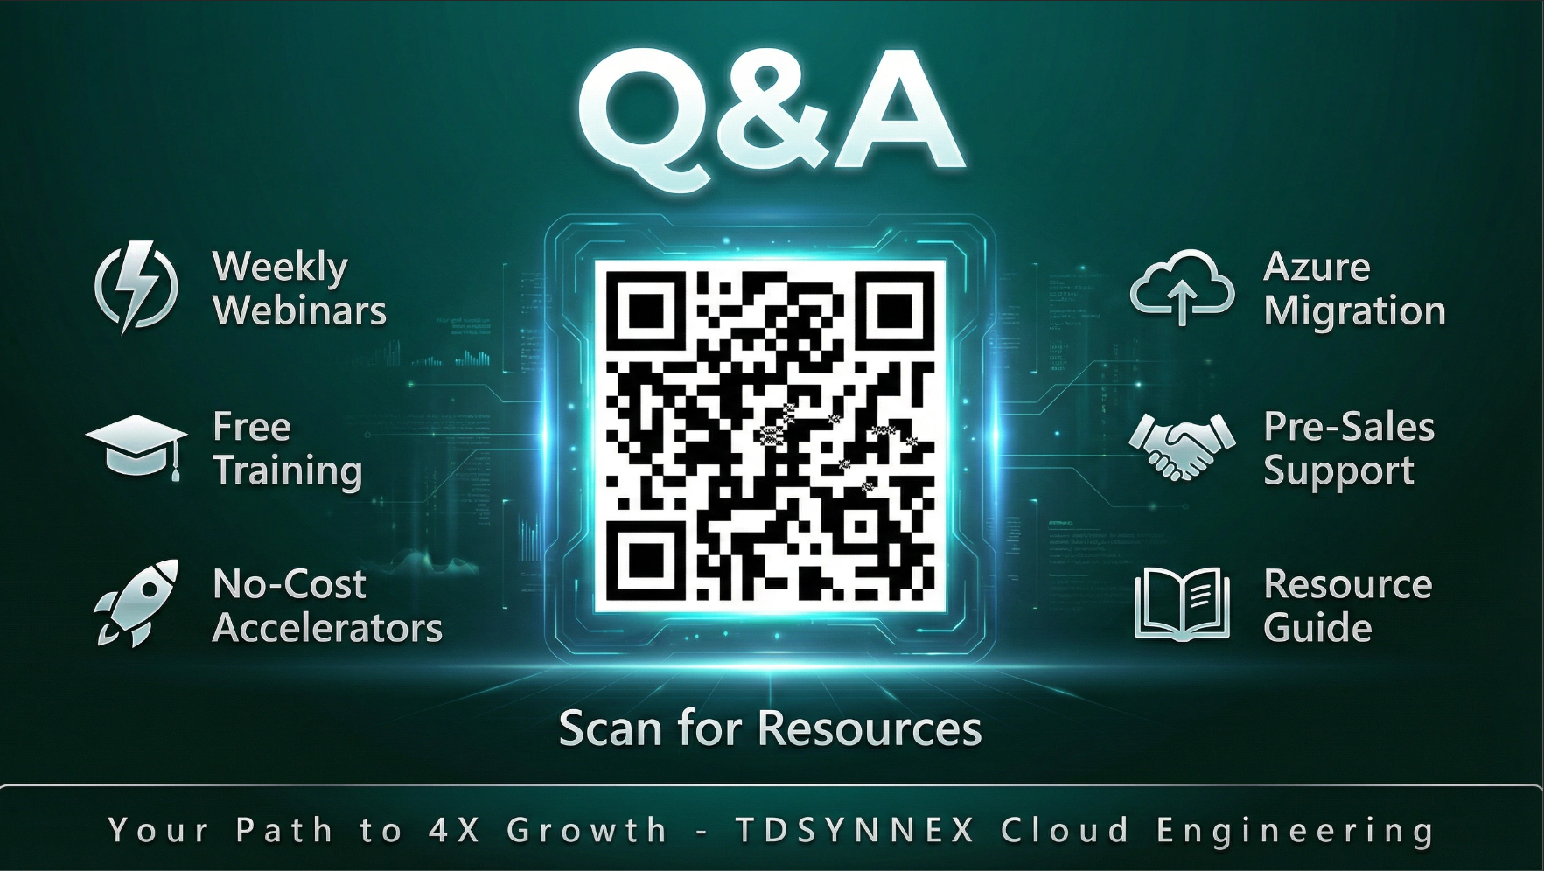

Slide 15

THANK YOU!

